Slide 1



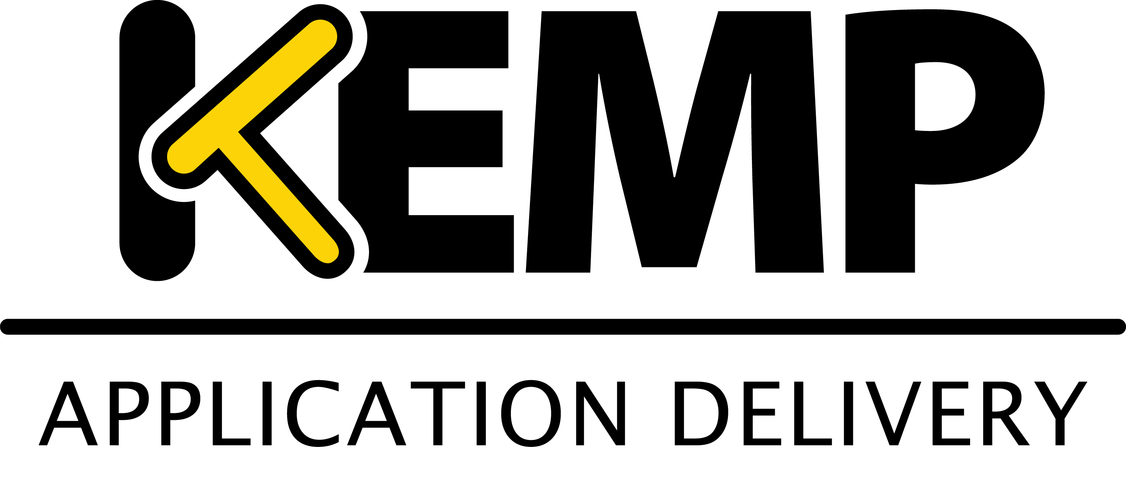


PowerShell Conference Asia
Infrastructure validation using Pester

Slide 2


About_Irwin
Blogging pshirwin.wordpress.com
GitHub irwins
Twitter @irwinstrachan
Contributor community.idera.com/powershell
PowerShell Conference
Singapore 2017
Notes:
Here’s a quick list of how you can get in contact with me.

Slide 3
Agenda
Why OVF and the benefits
Basic concepts of OVF
Writing OVF Test
OVF Gotcha’s
Demos
Comments
PowerShell Conference
Singapore 2017
Irwin Strachan – Senior Consultant @Methos
Notes:
Here’s what’s ahead of us.
We’ll get into OVF and the benefits.
JEP (Just Enough Pester) to get you started with OVF
Some ideas on how to go about setting up your OVF tests
Quick show of hands, How many have used Pester and familiar with the basics of Pester?

Slide 4
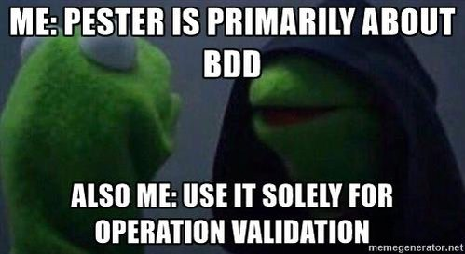
PowerShell Conference
Singapore 2017
Irwin Strachan – Senior Consultant @Methos
Notes:
I think the reason OPS guys have a hard time writing tests is that we just want to get things done. Writing tests is all about refactoring you code to make sure it still produces to outcome you expected. I’ll be describing that in my next talk.
If I need to create a batch of users in AD. I’ll probably use a csv file. If I configure it with the right headers in place I can easily pipe that directly to the New-ADUser cmdlet!. Sure I could get creative and try mocking New-ADUser. When in doubt, less is more! Your test should have added value. If it’s complicated then you’re doing it wrong!
While learning about Pester I stumbled on a great example by Kevin Marquette doing Operation Validation. I had almost given up on Pester thinking “Well maybe this is one tool I won’t be using frequently” When I saw his example it blew my mind… Wait you can do that??? After that Pester made sense to me as an Ops guy… Still working on the Dev part… ☺

Slide 5
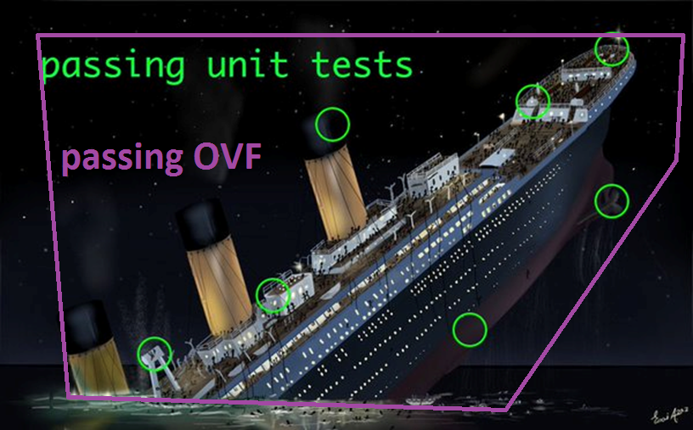
PowerShell Conference
Singapore 2017
Irwin Strachan – Senior Consultant @Methos
Notes:
This gets me every time I sit down to write Pester test for my code. I get why testing your code is important, it’s all about refactoring, making sure that your code still does what it is suppose to after changes have been made. Ops are more interested in the outcome than the code being used. With OVF testing it’s about the end result. Did my (automated) process do what I expected?
See the ship? All the green dots are units test that passed. OVF is looking at the ship in it’s whole. It doesn’t do the ship any good to pass a million unit tests and still sink.

Slide 6
Why use OVF Tests
No eyeballing the expected results
If possible use the source input used to automate the process
Verify operational functionality
Rectify any discrepancies
PowerShell Conference
Singapore 2017
Irwin Strachan – Senior Consultant @Methos
Notes:
No eyeballing the test results
Before OVF my validation would be a quick assessment of a few “key” users. If I like what I see then I’d assume the rest is ok. And there in lease the rub… Assumptions… Is the mother of all… Right… Instead of eyeballing the results you should write OVF tests.
If possible use source
I say if possible, use it. The great thing about OVF is that you decide what needs to be in place. Ideally you will be using the input you used to automate a process to validate the outcome. If that isn’t the case you can still model the input to your liking.
Verify operational functionality
Think taking an environment into production. If you weren’t part of the team that deployed it you can still use OVF to validate that it’s been deployed correctly once you know what is expected. If your still using a checklist, think OVF!

Slide 7
Coming up!
JEP (Just Enough Pester) for OVF.
AD OVF
AD snapshot
AD Operation readiness
OVF Gotcha‘s
PowerShell Conference
Singapore 2017
Irwin Strachan – Senior Consultant @Methos
Notes:
So Let’s go through Just Enough Pester coverage for OVF so you get an idea how you can go about creating your own test
Next I’ll show you my infamous AD OVF test
And last some OVF Gotcha’s

Slide 8
Just Enough Pester
Blocks
Describe
Context
It
Before-,After-
Assertions
Should
Operators
Be,BeIn,BeExactly,BeLessThan…
Contain,ContainExactly…
Match, MatchExactly
Exists
TestCases
PowerShell Conference
Singapore 2017
Irwin Strachan – Senior Consultant @Methos
Notes:
Describe
Everything starts with the Describe block. Describe represents everything that happens within it.
Context
Context provides a logical grouping for your assertions (It blocks)
It
These can either exist in Describe or Context block. This is where the magic happens. Here’s where the assertions take place and will either pass or fail a test. Keep the It block as clean and as simple as possible
Before- After-
The BeforeAll, BeforeEach,AfterAll and AfterEach can contain code you need to get things set up.
BeforeAll run before any It block runs. AfterAll runs after all It bloack ran.
BeforeEach run before each It block, so if you have 5 It Blocks BeforeEach will run 5 times. Same goes for AfterEach.
Testcases
Testcases cases are a great to pass a set of parametes to an It block to test different scenarios. Basically testcases are just Hashtables holding values for a specific scenario. Be sure to add a few scenarios that will fail! Remember, never trust a test that doesn’t fail!

Slide 9
Writing OVF Tests
Create Snapshots
If possible use source used to automate the process
Verify operational functionality
Rectify any discrepancies
PowerShell Conference
Singapore 2017
Irwin Strachan – Senior Consultant @Methos
Notes:
Create snapshots
So the way I start with writing OVF is creating a snapshot. The snapshot is where I’ll gather what the current status is of what I’m testing. This will usually be a series of Get cmdlets in PowerShell. I’ve been asked on numerous occasions why use a snapshot?
Captures a specific state in point of time. Things change sometimes unintentionally. Having various snapshot can help you assess when something has changed.
Accumilates a history of Information. Great for data-mining
Gateway to other processes. I‘ve used the snapshot to generate Pscribo documents, but also send data to a slack channel if necessary.
If possible use source
I say if possible, use it. The great thing about OVF is that you decide what needs to be in place. Ideally you will be using the input you used to automate a process to validate the outcome. If that isn’t the case you can still model the input to your liking.
Verify operational functionality
Think taking an environment into production. If you weren’t part of the team that deployed it you can still use OVF to validate that it’s been deployed correctly once you know what is expected. If your still using a checklist, think OVF!

Slide 10
Demo Time!
JEP (Just Enough Pester) for OVF.
AD OVF
AD snapshot
AD Operation readiness
OVF Gotcha‘s
PowerShell Conference
Singapore 2017
Irwin Strachan – Senior Consultant @Methos
Notes:
So Let’s go through Just Enough Pester coverage for OVF so you get an idea how you can go about creating your own test
Next I’ll show you my infamous AD OVF test
And last some OVF Gotcha’s

Slide 11
Take away
Pester is also Ops not just Dev
OVF is more the mindset of Ops
Never trust a Test that doesn’t fail
OVF is about testing what’s critical or mandatory
Have fun Learning Pester!
PowerShell Conference
Singapore 2017
Irwin Strachan – Senior Consultant @Methos

Slide 12
Reading material
A different pitch for Pester
Writing Pester Tests - PowerShell team
Sapien Pester Blogs
Pester Wiki
The Pester Book – Adam Betram
PowerShell Conference
Singapore 2017
Irwin Strachan – Senior Consultant @Methos
Notes:
It’s time for some demo!

Slide 13
Don’t Forget!
Fill in your survey in Mobile app – it’s how we do better!
Don’t lose you badge! You need it for the Social Events
Grab the Speakers for a chat – they all have time for you!
Let everyone know what they are missing on Social Media
#PowerShell
#PSConfAsia
Photos of Marina Bay Credit: Sebastian Szumigalski
PowerShell Conference
Singapore 2017

